Slide 1
Foundation Phase Education Resource

Slide 2
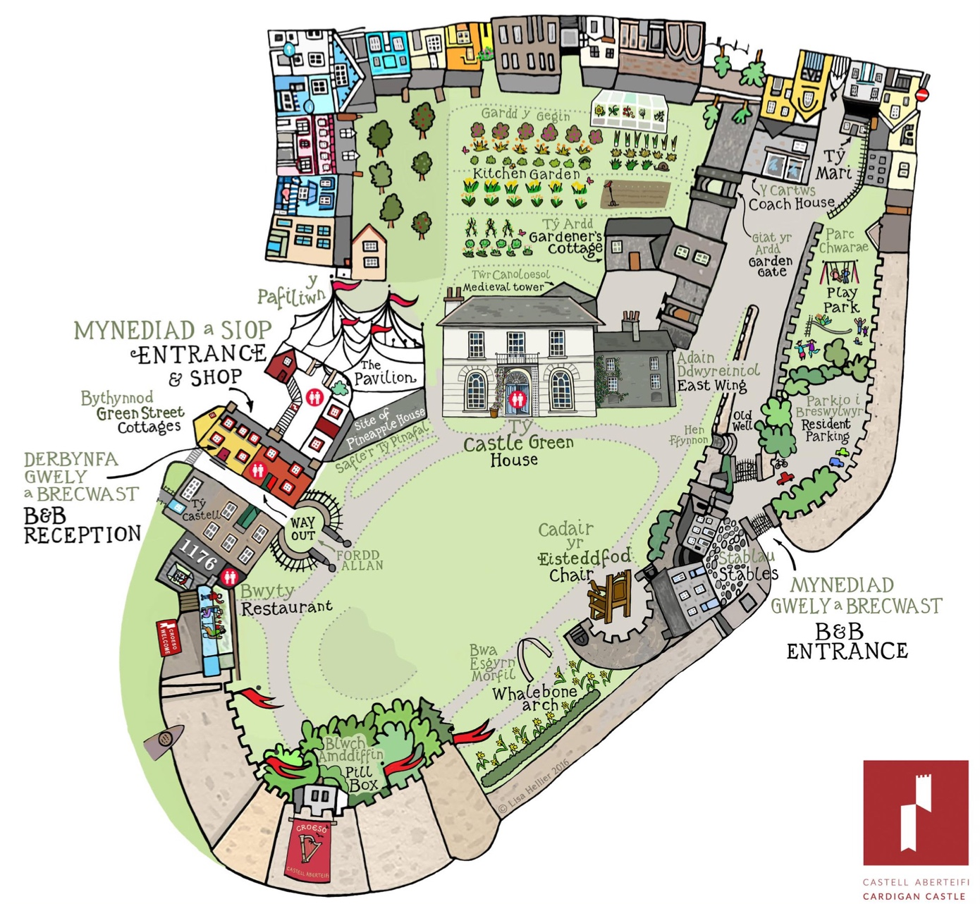
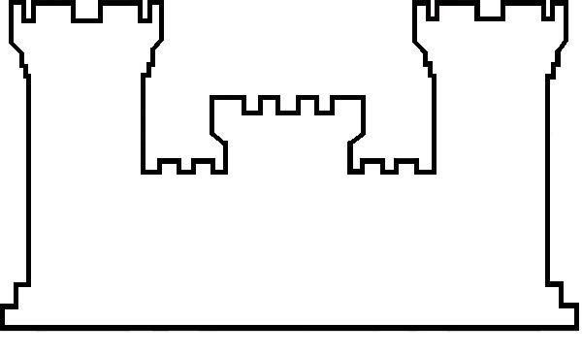
Can you spot where everything is on the map?
Helpful information for your teacher
If travelling by coach or bus, there is a designated public bus stop to drop groups off directly opposite the castle entrance on a one-way road through Cardigan town. Pre-arranged trips can request a member of staff to assist with crossing the road. The closest with coach parking is behind the council run car park next to the Theatre Mwldan SA43 1JY. The Castle postcode is SA43 1JA.
When you arrive at the castle, your group will be fast-tracked through reception with tickets and information leaflets given to the person in charge for distribution. Please note that we do not permit ball games or similar activities onsite.
Wheelchair access is provided where possible. The main grounds and Castle Green House are accessible by wheelchair. However, the kitchen gardens and play area have restricted access. There are toilet facilities located in the Reception area where there is a toilet suitable for wheelchairs.
If a child becomes lost and unable to remember the pre-arranged meeting point with their group, they should approach a member of staff for help.

Slide 3
2015
CARDIGAN CASTLE OPENS TO VISITORS
2003
CEREDIGION COUNCIL BUY CARDIGAN CASTLE
1940
WORLD WAR 2 PILLBOX IS BUILT
Draw the World War 2 Pillbox.
1644
THE CIVIL WAR
Draw the cannonball hitting the castle wall.
1808
CASTLE GREEN HOUSE IS BUILT
Draw Castle Green House.
1376
PRINCESS JOAN RUNS CARDIGAN
Draw Princess Joan.
1176
FIRST EISTEDDFOD
Draw the Eisteddfod Chair.
1349
THE BLACK DEATH
Draw 7 houses like the ones you see around town.
1165
LORD RHYS CAPTURES CARDIGAN CASTLE
Draw Cardigan Castle.

Slide 4
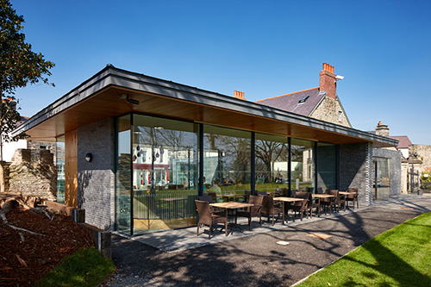
STOP 1: 1176 Restaurant
The restaurant within the Cardigan Castle grounds is a new building. It was built where 30 metres of the West Wall had fallen down in 1984.
Take a look around and discuss the other buildings you see alongside the old castle walls.
Draw the buildings and walls you can see in the space above.
Put a square around the features you see that are similar, and a circle around those that are different. You may find that the buildings are completely different!

Slide 5
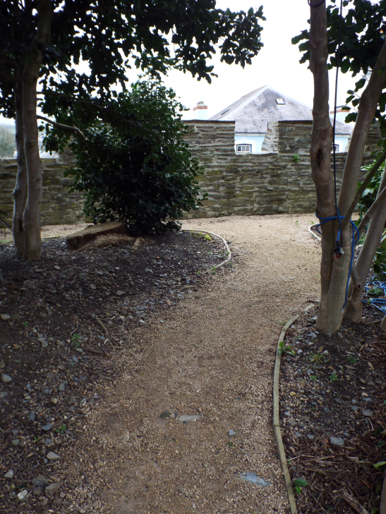
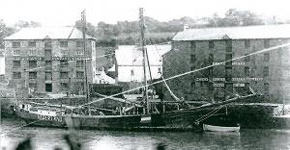
STOP 1:
South Castle Wall
Walk to the castle wall and look out over the wall. Cardigan was a busy port many years ago. Look at the view, and then look at the picture below. Can you spot the differences?
Draw 2 things you see that are not in the picture.
Image taken from http://cardigan-maritime.com/through-the-ages/ports-and-trades.html

Slide 6
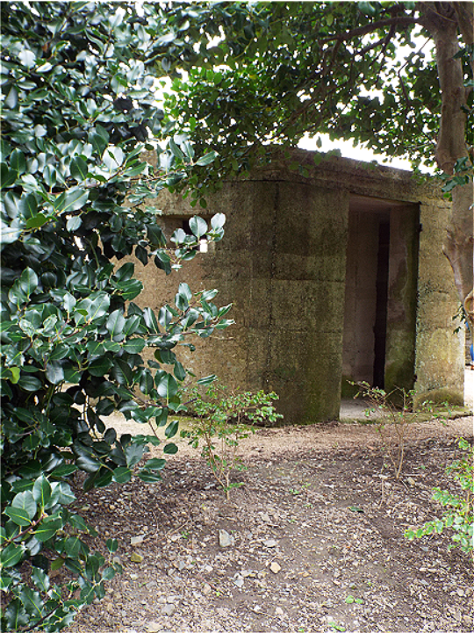
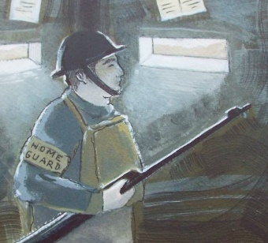
STOP 2:
World War 2 Pillbox
This square box was built by the local Home Guard to look out for enemy ships. Soldiers kept watch the same way as medieval soldiers had done hundreds of years before.
Describe what you see, feel, hear, and smell
Imagine you are one of the Home Guard. Take it in turns to go inside the Pillbox and look out for the enemy. Make sure you do not sound the alarm accidentally. The word may get back to the airfield and we will see our pilots overhead ready to attack.

Slide 7
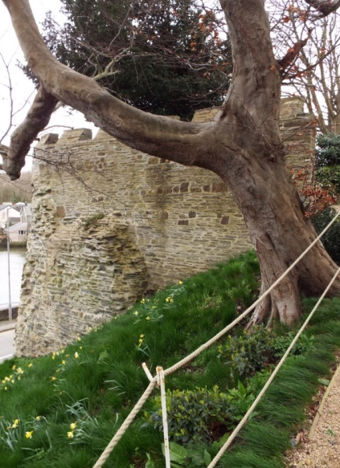
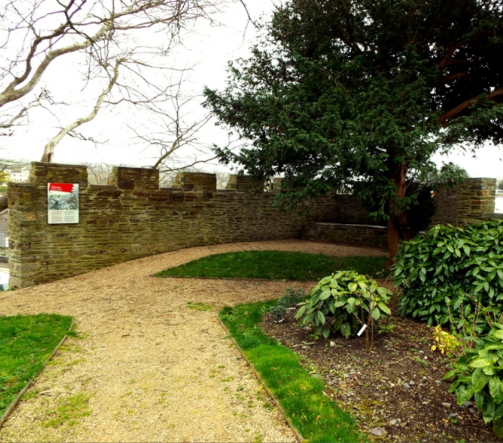
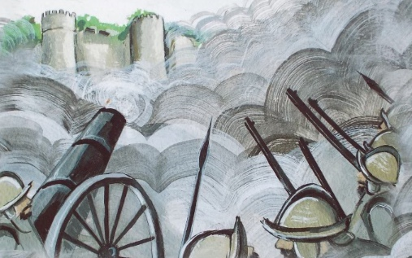
STOP 3: Southeast Tower
Cardigan Castle came under attack in 1644. It was a very dangerous place to visit with cannons firing and musket balls whizzing past your head all the time.
Listen to the short story your teacher tells about the Civil War. Look closely at the tower after the story has finished. Can you see where the cannonball hit the tower?

Slide 8
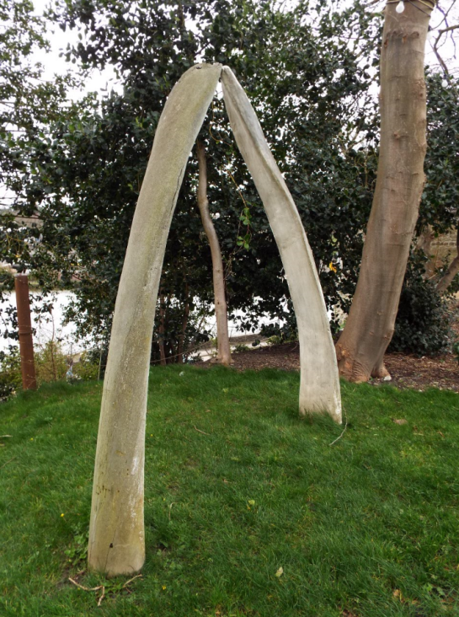
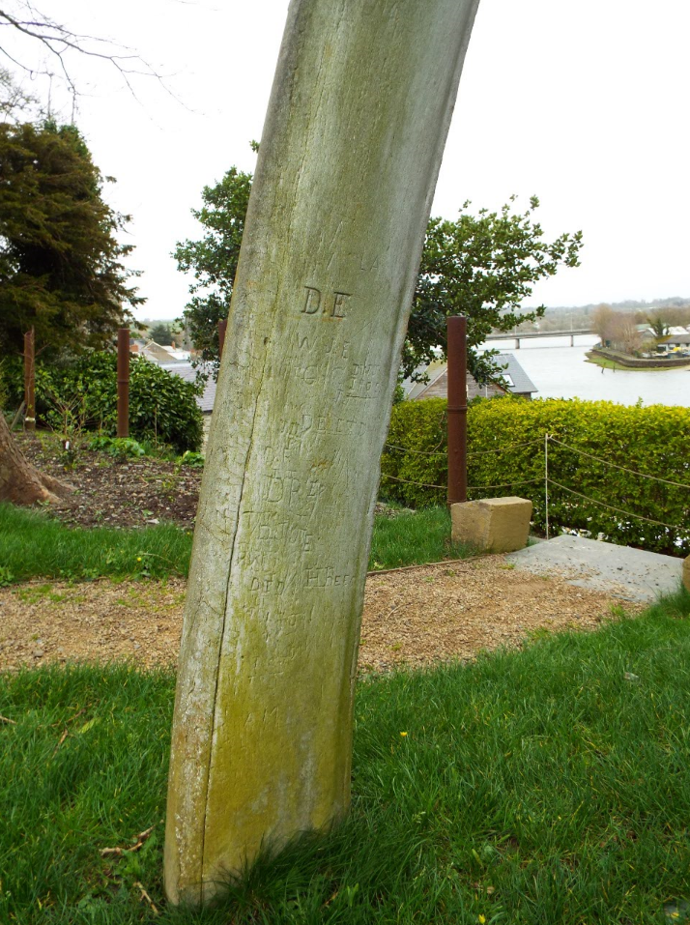
STOP 4:
Whalebone Archway
This arch is made from the jawbone of a Wright Whale. It was a wedding gift from a sea captain in the 1860’s. The arch was placed here to frame the view of the river behind it.
There is something special about the Whalebone Archway, can you see what it is? You may have to look closely!
Use this box to write down the letters you can see.

Slide 9
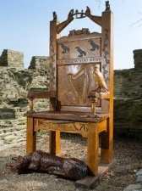
STOP 5:
Eisteddfod Chair
This is the East Tower of Cardigan Castle. The stone steps at each side go down to the old toilets. They sat above the river so the water below washed the waste away.
Lord Rhys held the first Eisteddfod in 1176. During this special event, he gave a chair to a poet and a musician as a prize. The pictures on the chair are symbols used to show what Lord Rhys was like. Describe the symbols you see with your teacher, and think about what they tell us about Lord Rhys.
Draw 6 of the symbols you see on the Eisteddfod Chair. There are many more symbols to spot. Can you see them?

Slide 10
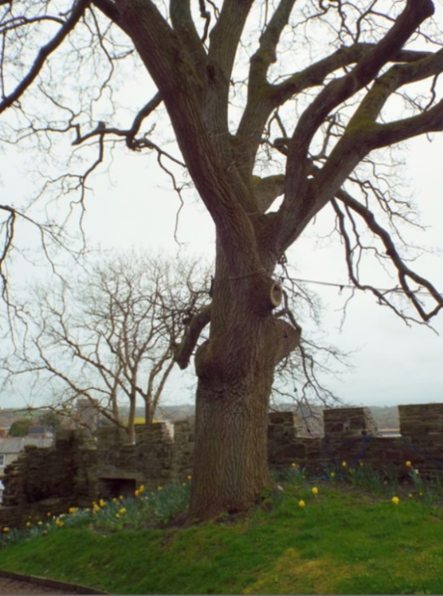
STOP 6:
The Turkey Oak
This is a rare type of tree planted in 1805 to decorate the garden. The Turkey Oak standing before you is older than the one planted in Kew Gardens.
There are 3 important things trees need to grow. They are
___ ___ ___ , ___ ___ ___ ___ ___,
and ___ ___ ___ ___ .
Draw the Turkey Oak

Slide 11
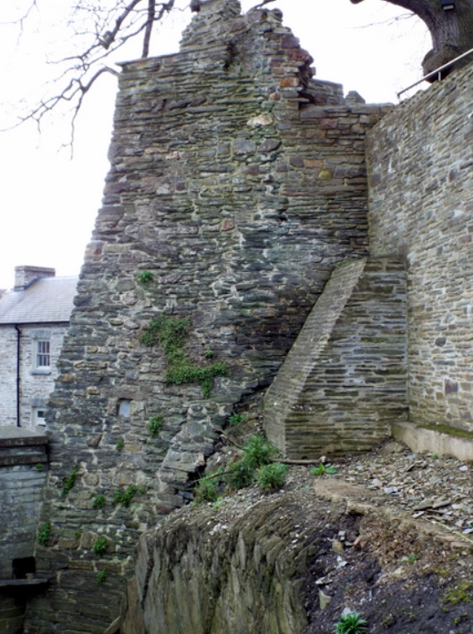
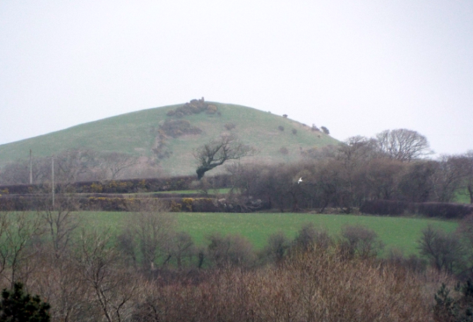
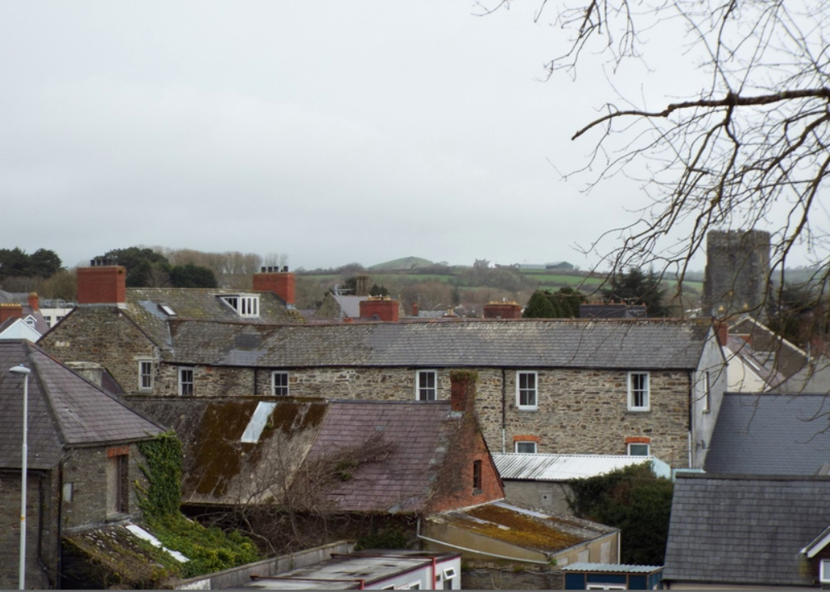
STOP 7:
Northeast Prison Tower
You have arrived at the old Prison Tower. Prisoners were walked from the castle to the hill in the distance where they were hung on the gallows for all to see.
Look over the tops of the houses to the hill in the distance. This is Banc Y Warren. Now draw a circle around it on the image below.

Slide 12
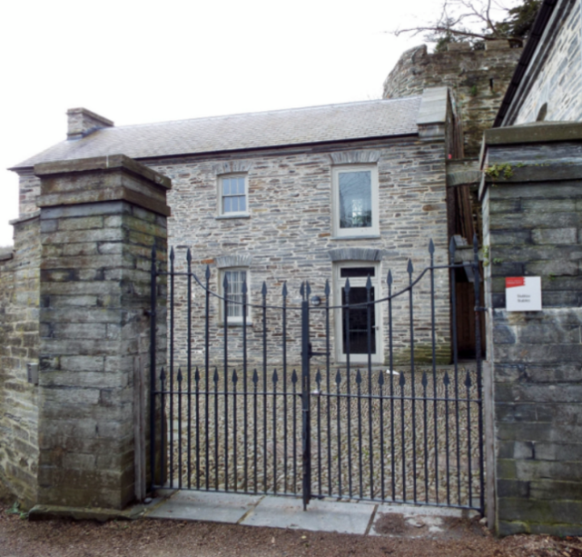
STOP 8:
The Stables
This is a great spot to see all the different layers of history Cardigan Castle holds.
Use this space to make stone rubbings of the walls and try to get two from each period in history. Remember to be careful with your crayons when making your rubbings.
Medieval | Medieval
Georgian | Georgian

Slide 13
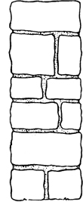
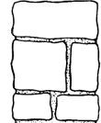
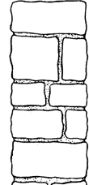
STOP 9: The Kitchen Gardens
We grow our own vegetables in the kitchen gardens. Can you see which ones? Draw what you see on the plan below.

Slide 14
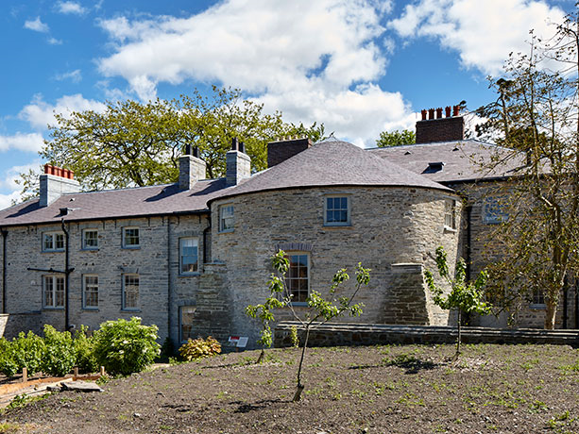
STOP 10: North Tower and the Outer Ward
This is the oldest part of the castle. It is part of the first stone castle built by Lord Rhys in 1171. The tower had more foundations added for extra support 100 years later. These stick out to the side of the round tower.
Follow the lines to draw the shapes you see when looking at the North Tower. Then try drawing the shapes on your own.

Slide 15
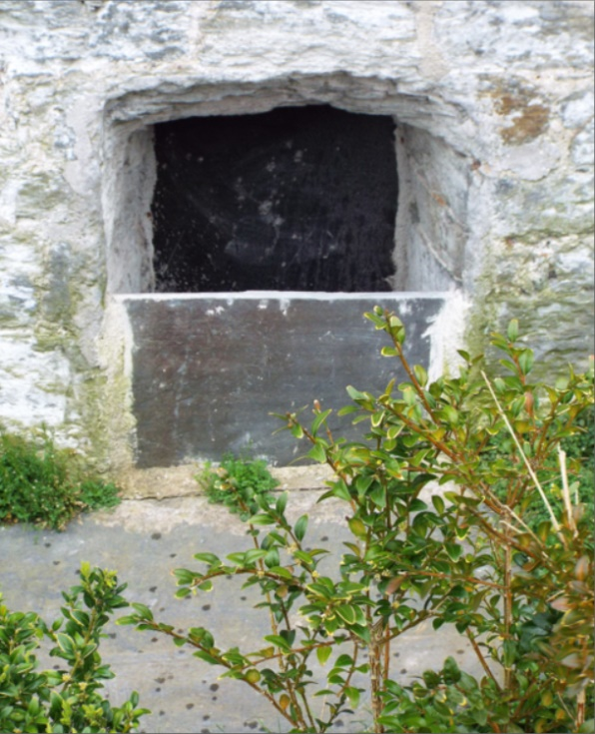
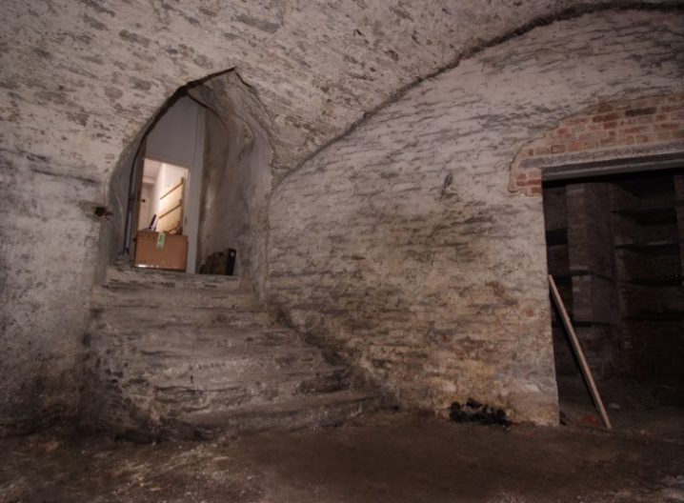
STOP 11:
Medieval Cellar
In the depths of the house lies the medieval cellar. It dates back to 1240 and is the oldest standing remains of the first stone castle.
Cardigan Castle is the home of some rare nocturnal animals.
Can you guess who lives in our medieval cellar?
CLUES: These animals like to eat insects, have big ears, and hang upside down when they are sleeping.

Slide 16
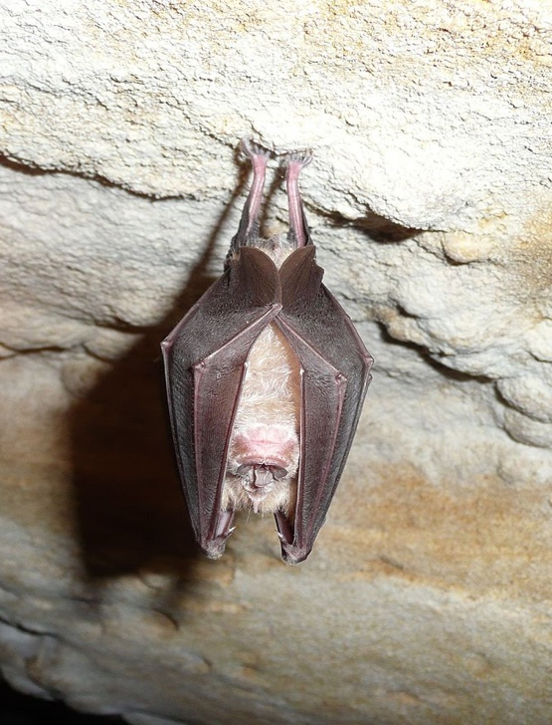
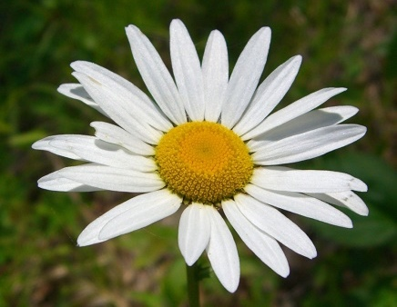
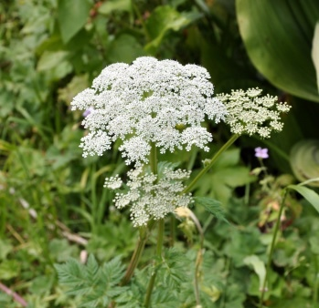
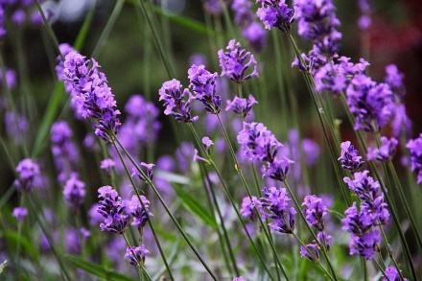
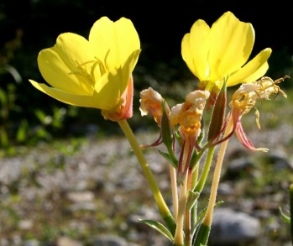
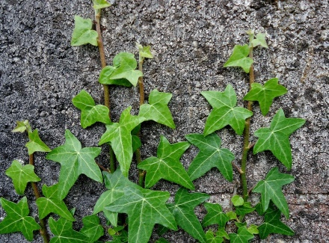
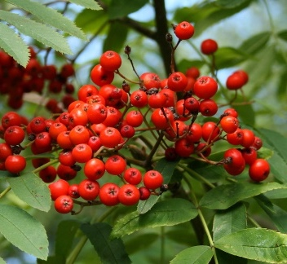
STOP 11:
Medieval Cellar
You guessed it!
The medieval cellar is home to our Greater Horseshoe Bats. The bats set up home 600 years ago and they now have ‘bat chutes’ to get in and out.
Look at the photograph of the medieval cellar on the last page. Discuss with your teacher what might make the medieval cellar a good place for our Greater Horseshoe Bats to hang out.
The kitchen gardens are like a banquet for Greater Horseshoe Bats. They love plants like lavender, daisies, and the common ivy.
Can you spot the plants above in the kitchen gardens?
Oxeye Daisy
Wild Angelica
Lavender
Primrose
Common Ivy
Mountain Ash

Slide 17
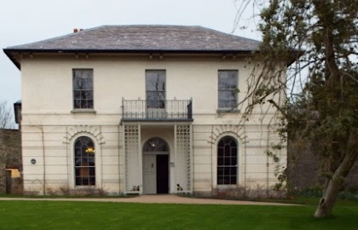
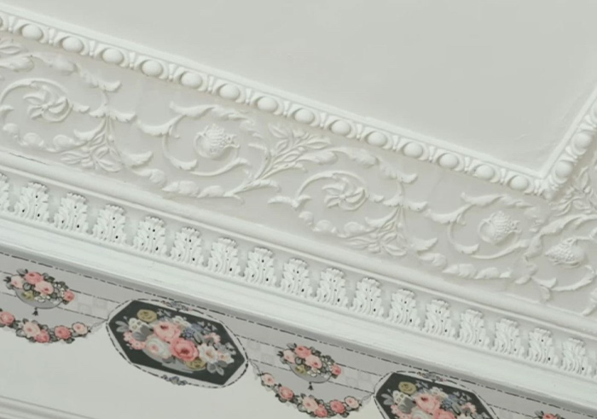
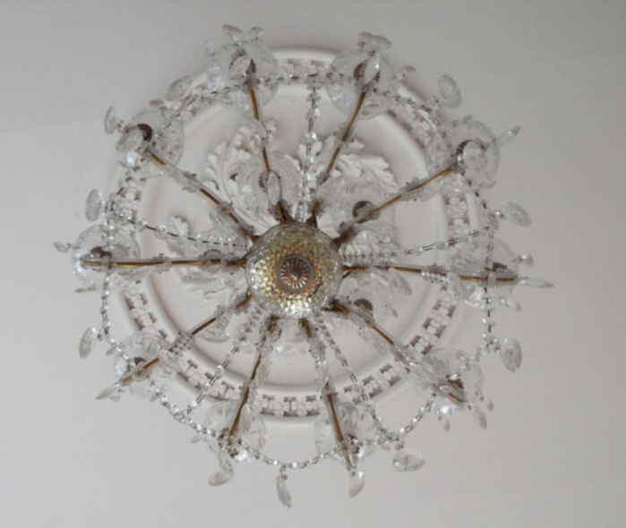
STOP 11: Castle Green House
The site and castle ruins were greatly changed by owner John Bowen. In 1808, he joined Castle Green House to the original castle structure. This is what we see today.
Look to see what different patterns and shapes you can find inside Castle Green House. Draw, or take photos, of what you see.
TOP TIP!
Remember to look up at the ceilings and check out the fireplaces.

Slide 18
Use this space to draw some of the patterns you see within the rooms of Castle Green House.
Try to finish the patterns on the page for practice.

Slide 19
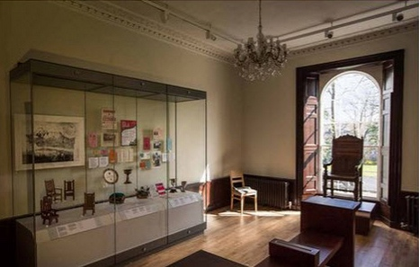
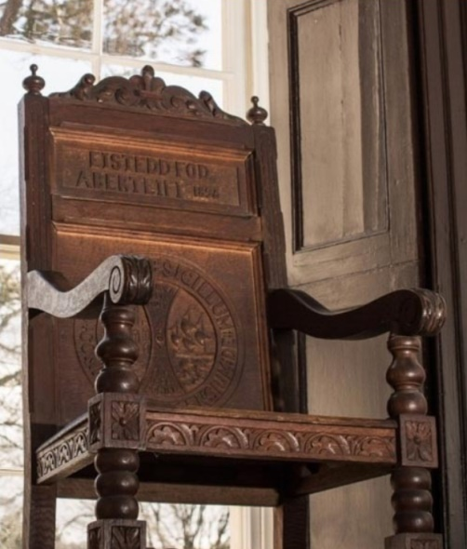
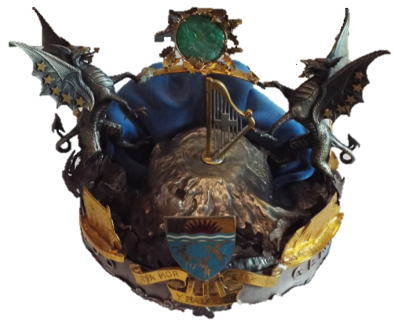
STOP 12: The Eisteddfod
The first Eisteddfod was held by Lord Rhys on Christmas Day in 1176. It was a special event with competitions in music and poetry. Many of the features of the National Eisteddfod today are taken from this important event.
Discuss what contests you have at your school Eisteddfod and think about whether they are similar to the ones at the National Eisteddfod.
Can you spot 2 Eisteddfod Chairs and 2 Eisteddfod Crowns?
These were given to the winners of the Eisteddfod festival.

Slide 20
The Eisteddfod Crown
Design your own Eisteddfod Crown for Cardigan in the box above. Remember to think about what is special to your local community and add them to your design.

Slide 21
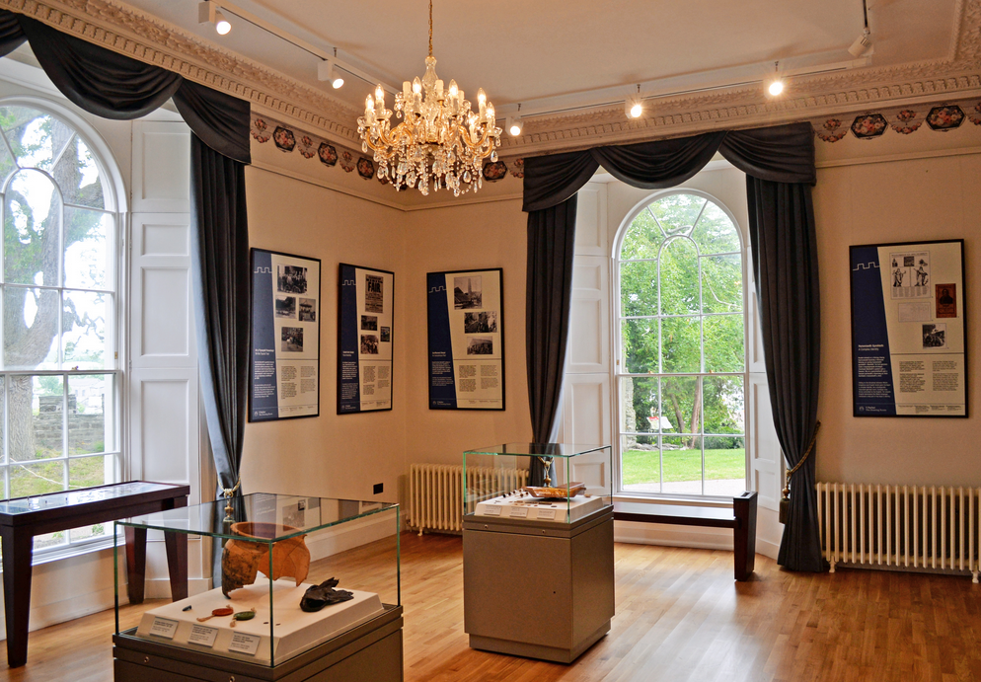
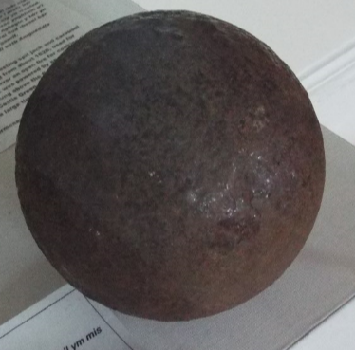
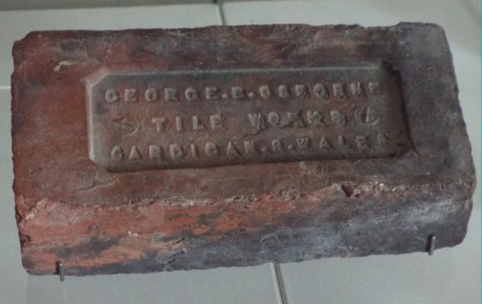
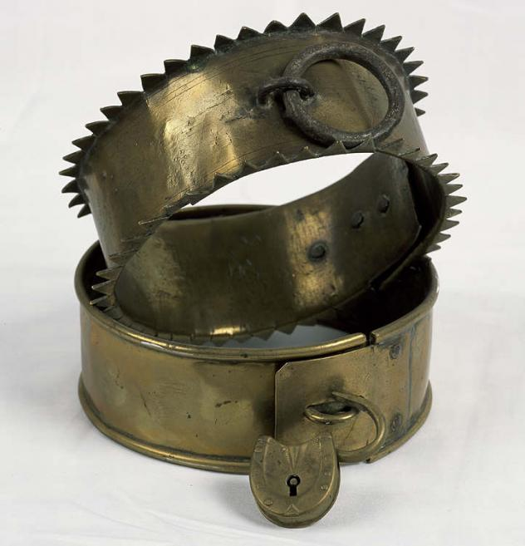
STOP 13: The Story of Cardigan
Cardigan was a busy port town . The people of the town lived off the sea and shipped materials to other countries. To do this they built ships here from Welsh Oak for fishing and carrying loads overseas.
Look at the objects in the glass case and see if you can find the items below. They are all from Cardigan and tell us about its history.
Find out what they are with your teacher and write down their names.

Slide 22
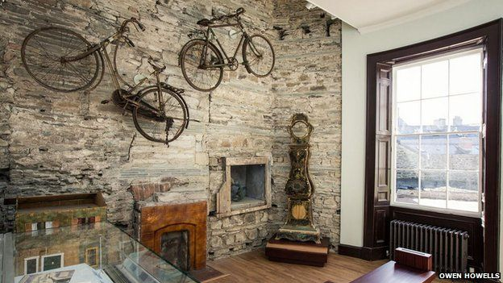
STOP 14: Miss Barbara Wood
Barbara Wood is the last person to have lived at Castle Green House. The house was hard to look after and soon fell into disrepair with many parts of the house left empty to rot. In 1984 the house was abandoned and Barbara Wood moved into a caravan.
Born: _______________
Died: _______________
Miss Barbara Wood moved into Castle Green House in ________. She soon found it hard to keep the house ___ ___ ___ ___ and it started to ___ ___ ___ ___ /
___ ___ ___ ___
Draw a portrait of Miss Barbara Wood
Find out more about Miss Barbara Wood and fill in the missing facts.

Slide 23
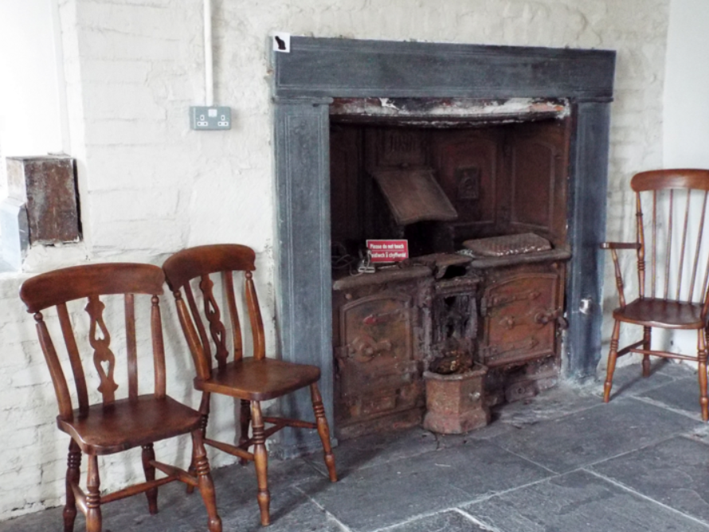
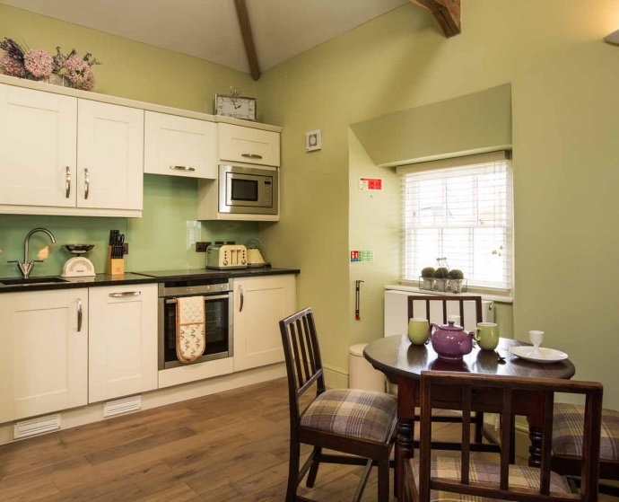
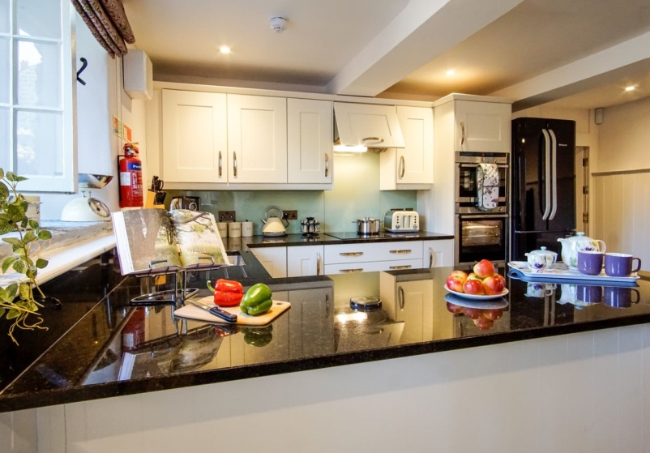
STOP 14: The Medieval Kitchen
You are standing inside the round North Tower of Cardigan Castle. The tower is round on the outside and the rooms on the inside are all square to make them easier to live in. It was round because the shape was stronger. This helped when the castle was attacked.
Look around the medieval kitchen and discuss with your teacher what is different to your kitchen at home. Use the pictures of modern kitchens below to help.

Slide 24
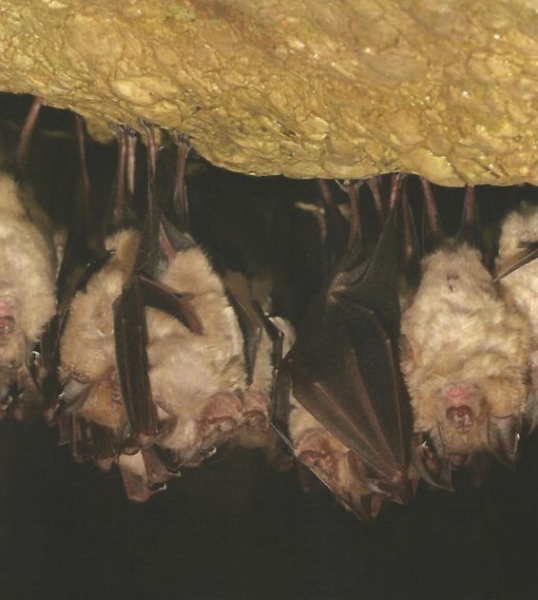
This is where you can see our Greater Horseshoe Bats via the BATCAM. Take it in turns to watch the screen and count how many bats you see. Write down the number below.
There are over 1,300 species of bat worldwide.
We have fewer wooded areas, ponds and open grass areas for bats to feed and roost. Bats have become threatened as a result. Greater Horseshoe Bats are one of the rarest species of bat.
Bats are not blind. They can see, but prefer to use their ears to catch food instead. Sound also helps them to find their way around.
DID YOU KNOW?
I saw……
… Greater Horseshoe Bats.

Slide 25
Teachers Notes for Foundation Phase
This resource is designed to help you get the most from your visit to Cardigan Castle. The first section is an activity pack to use with students whilst visiting the castle. It contains a variety of activities for students to do onsite with the help of their teacher or adult helper. The next section aims to help with classroom learning and provides activity ideas to do in the classroom.
Foundation Phase National Curriculum Links
Language, Literacy, & Communication
Imitate real-life experiences using role-play, and contribute to activity using relevant language.
Show understanding of basic concepts of story & participate in discussion, exchanging ideas.
Participate & contribute to discussion using a variety of questions and choosing words deliberately. Use images to aid understanding.
Mathematical Development
Recognise and name common 2D shapes, & some 3D shapes.
Copy a range of simple patterns & demonstrate understanding of repeated patterns.
Compare, sort and order objects using direct comparisons. Use non-standard units to measure.
Knowledge & Understanding of the World
Use simple maps to find out where places are
Identify differences in way of life at different times using historical resources.
Using a range of historical sources (e.g. artefacts)
Making observations and keeping records.
Learn the names of the main external parts of the plant.
Identify some plants that live in the outdoor environment.
Identify the effects different seasons have on plants.
Observe differences between different animals.
Investigate how places change.
Creative Development
Explore & experiment with different techniques & materials.
Develop understanding of planning, designing, modelling, modifying & reflecting.

Slide 26
School Visit Timetable
The below is a suggested timetable for your visit to Cardigan Castle.
 | Activity
Time | Group 1 | Group 2
9:30am – 9:40am | Arrival at Cardigan Castle We have an Education Room available for you to place lunch bags in before starting your exploration of the site. Please remember not to leave any valuables in the room and take them with you for safe keeping.
9:40am – 10am | Introduction Video & Activity Start your adventure with a short 7-min video about our history. Afterwards, take the group outside to complete the timeline. | Activity & Introduction Video Stay with your group in the grounds whilst waiting for the first group to finish. Try the map reading activity and start working on your timelines.
10am – 12noon | Cardigan Castle Grounds Explore the grounds of Cardigan Castle with your group to discover more about the 900 years of history the castle has seen. Use the resource pack to guide you around the site and complete the different activities within the pack to learn more about our history and the people in it. | Castle Green House Step into Castle Green House with your group to spend the morning exploring the house with its many layers of history. Use the resource pack to take you round the different rooms and dig deeper into our local history. There are lots of different activities to complete along your journey through the house that look at local history and the Eisteddfod.
12noon – 12:45pm | LUNCH! If you would like a more private space to eat your lunch, please let us know before your visit, and we can arrange for our Education Room to be available at the time of your visit. Please ensure that all rubbish is placed in the bins provided.
12:45pm – 2:45pm | Castle Green House Step into Castle Green House with your group to spend the morning exploring the house with its many layers of history. Use the resource pack to take you round the different rooms and dig deeper into our local history. There are lots of different activities to complete along your journey through the house that look at local history and the Eisteddfod. | Cardigan Castle Grounds Explore the grounds of Cardigan Castle with your group to discover more about the 900 years of history the castle has seen. Use the resource pack to guide you around the site and complete the different activities within the pack to learn more about our history and the people in it.
2:45pm – 3pm | Departure back to school There is time here to collect bags from the Education Room and have a quick look in the shop before heading back to school. We would recommend here for you to visit the shop in small groups.

Slide 27
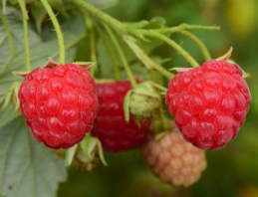
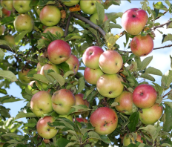
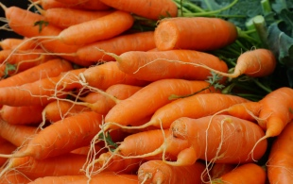
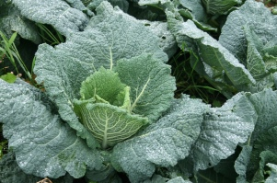
Classroom Activities
Knowledge & Understanding of the World
Identifying plants that live in the outdoor environment & the effects different seasons have on plants.
Taste some of the vegetables seen in small groups. Lay at least six different fruit and vegetables you saw in the kitchen gardens on a table. Ask the children to guess what you have on the table and discuss where you saw the plants. The students will then take it in turns to name and describe the fruit or vegetable they have using sight, touch, smell, and taste. To expand the activity further, ask the children to label the drawings they made of the different types of plants they saw in the kitchen garden on their visit with adult support.
TOP TIP! Try using a blindfold to make the activity more difficult, and see if your class can guess what vegetable they are eating.
What we grow in the kitchen gardens at Cardigan Castle:
Grow your own fruit and vegetable garden at school by collecting an array of different plant pots and transforming your classroom windowsill into a garden. You can then keep a close eye on it throughout the year. This activity would be great outside on a small plot of land. See if you have space within the school grounds with the help of your caretaker, or take the opportunity to build links with your local community and enquire about using a small plot in your local allotments.
TOP TIP! You can build the garden into a sensory garden by planting different types of plants, such as herbs, fruits, and vegetables. This is great for younger children and children with ALN. For a useful website about what to plant in your garden go to https://schoolgardening.rhs.org.uk/resources/info-sheet/plants-for-a-sensory-garden

Slide 28
Knowledge & Understanding of the World
Exploring & Experimenting
Look at which material would be the best one to make a shield in a simple science investigation. Gather together samples of wood and steel for the children to test from your local hardware store (i.e. short wooden planks, or steel plates). Discuss together what the different materials are and look at each one closely using the sense of touch and sight. Ask the children to predict which one will be the best material for their shield before starting. Think about the strength of each material and how much they weigh. Test each one to see which is the strongest by raising each sample off the table and trying to break the samples by adding weights on top of each sample. Observe what happens and confirm which material was the strongest, or if they were both the same. For safety ask the children to wear gardening gloves and plastic eye googles.
Mathematical Development
Compare, sort and order objects using direct comparisons. Use non-standard units to measure.
Cardigan was a bustling port for many years sending slate, leather, steel chains, and tinplate all over the world. Gather samples of each material for small groups to sort them into four piles based on observation. Allow the children to hold each sample and discuss what the differences or similarities are between the materials. Think about how heavy each material is, whether they are smooth or soft, and what each material was used for (e.g. clothes, food packaging, shipbuilding, and building house roofs).
Knowledge & Understanding of the World
Develop understanding of planning, designing, modelling, modifying & reflecting.
Build a LEGO castle and see if you can make it look like Cardigan Castle. This activity can be put out in the construction area for children to try after doing the guided activity in small groups with adult support. See how someone has made Caerphilly Castle with LEGO
http://www.carneycastle.com/Caerphilly/ and check out the following videos from CADW of their LEGO castles coming to life
https://www.youtube.com/watch?v=h7Sb529wNhs (Rhuddlan)
https://www.youtube.com/watch?v=BVo1JxIhN7Y (Caernarfon)

Slide 29
2
2
1
1
2
2
2
1
1
2
Use the key below to help you colour-in the shield.
1
Red
2
Yellow
Creative Development
Explore & experiment with a variety of techniques & materials.
The shield above was used by Lord Rhys in battle to show people who he was. It is painted with his own special logo to represent his family. Choose and use different materials to colour-in the picture above for Lord Rhys.

Slide 31
Creative Development
Explore & experiment with a variety of techniques & materials.
Lord Rhys held the first Eisteddfod at Cardigan Castle in 1176. This is a chair made for Cardigan Castle to commemorate the first Eisteddfod. Add colour to the Eisteddfod Chair using different materials and see if you can spot the different animals.

Slide 32
The War Between Two Sides
It was June 1644, and Colonel John Gerrard stood across the river at his prize - Cardigan Castle. In front of him were hundreds of soldiers clad in armour and sweat celebrating a great victory against their enemy, the Parliamentarians. They did not support the King and were fighting for Parliament to rule the country instead. Colonel John Gerrard and his soldiers wanted something different. They were part of the Royalists, who believed the King was the rightful ruler of the land. It was a glorious victory with the castle standing tall on the hill above the River Teifi.
The following morning, Colonel John Gerrard and his men set about strengthening the castle defences. Together they built a large hill within the castle yard to allow the cannons to fire over the walls and across the river. It was hard work, and every so often, the soldiers saw men moving the two hundred enemy soldiers captured across the yard to the prison cells below ground.
Peace did not last long. In the depths of winter, enemy soldiers led by General Laugharne returned to capture Cardigan Castle, and make it theirs once more. The town surrendered and the enemy attacked the castle. For two long weeks, cannon fire bombarded the castle walls, and the soldiers fighting within the castle walls eventually came out into the open where they were captured. The Parliamentarians stormed the castle to claim what had once been theirs.
Colonel John Gerrard and his men retreated, only to return soon afterwards with a large army, and take their revenge. Cardigan town was once more taken, and the castle attacked. The Colonel’s men fought hard to weaken the enemy. They destroyed Cardigan Bridge and attacked supply boats to stop food supplies from reaching the castle, but the enemy held their positions. It was not long before more enemy soldiers came to help the Parliamentarians stuck inside Cardigan Castle. The men who came saw the broken bridge, and yet did not fear, as they crossed the river using pieces of wood they found nearby. Soon, the enemy forced Colonel John Gerrard and his army away from the castle one more time. General Langharne had succeeded in defending Cardigan Castle. Yet, just months later his forces finally fell when Colonel John Gerrard attacked again in May 1645. This time, the castle buildings were set on fire, and all that remained when the flames died down were just empty stone ruins.
The above story is to be used on your visit to Cardigan Castle whilst at Stop 3. It is based on real-life accounts from soldiers who fought here during the Civil War from 1644-1645. Tell the story to your group and see if you can spot the damage made by the cannon to the Southeast Tower.

Slide 33
Knowledge & Understanding of the World
Observe differences between different animals
This is a great introduction activity to do before your visit to Cardigan Castle. Start by looking at what a Greater Horseshoe Bat looks like and the sounds they make by using the below link:
http://www.bbc.co.uk/nature/life/Horseshoe_bat#p00gfxhp,http://www.bats.org.uk/pages/listen_to_and_watch_bats.html . Explain that Greater Horseshoe Bats like to live in dark, dry, draft-free rooms with stone walls. These conditions provide the bats with a range of temperatures and humidity settings to avoid extreme changes to their body heat. Play ‘the perfect boost’ game from the Devon Bat Project to support learning at http://devonbatproject.org/find-the-perfect-roost-game/ .
Your visit to Cardigan Castle will support the learning you have done in the classroom beforehand. At Stop 11, discuss what Greater Horseshoe Bats look for in a place to hang out when you visit Cardigan Castle. Encourage groups to think like a Greater Horseshoe Bat and about what the medieval cellar offers them in a home. Think about what the medieval cellar is like and explain that although we may not like it, the bats love it.
Knowledge & Understanding of the World
Observe differences between different animals
Work in small groups to find out what Greater Horseshoe Bats like to eat at a banquet. Prepare for the activity by laying out samples of lavender, daisies, common ivy, bishops weed, primrose, purple top, and mountain ash plants on paper plates. Explain that Greater Horseshoe Bats love to eat these and compare them with food the children eat. Look at where you may find them in a kitchen garden. Ask the children to draw a tree, pond or some soil on the plate to help remind you where to plant them in your garden. The Devon Bat Project have a really useful resource to help with this activity at http://devonbatproject.org/wp-content/uploads/2016/07/Stars-of-the-Night-Sky-booklet.pdf
Creative Development
Explore and experiment with a variety of techniques.
The following is a simple activity to do alongside those above before your visit. Ask the children to make an origami bat out of black paper using the instructions from the Bat Conservation Trust at http://www.bats.org.uk/data/files/Origami_Bat.pdf . Finish the bats off with a pair of googly eyes and keep safe until your visit. The children can bring the bats with them on their visit.

Slide 34
The Medieval Cellar

Slide 35
Creative Development
Explore and experiment with different materials.
We have found many different archaeological finds at Cardigan Castle over the years, including lots of medieval pottery. Make your own small clay thumb pots and decorate them with patterns using the end of a thin paintbrush.
Language, Literacy & Communication
Imitate real-life & contribute to activity using relevant language.
Cardigan Castle have had several archaeological digs over the years. One of these revealed a medieval archway. Deliver a guided group activity that shows how to uncover the history lying underneath the soil. Start by transforming the role-play area of your classroom into an archaeological dig with a large sandpit filled with compost soil and small tools for digging, such as a trowel and paintbrush, inside. Hide different objects underneath the soil for the children to find and work with them to slowly and carefully uncover the objects. These could be blunt pieces of broken pottery that you have sanded down, or some old coins. Discuss the different tools that archaeologists use when on a dig and that each one is used fro different things. The brush, for example, is used to brush dirt
away delicately from around a small object, whilst the trowel is used to move large amount of dirt around larger objects. Allow the group to dig and discuss what they find together.

Slide 36
Archaeologist Record Sheet
Short description of object | Size of Object (large or small) | Time Period | Draw where you found the object
Imagine you are an archaeologist at Cardigan Castle. Dig carefully in the soil to find the hidden objects that have been buried over the years. Use the above table to record what you find on your big archaeological dig.

Slide 37
Risk Assessment
Vehicle traffic | The castle grounds are closed to public vehicles during opening hours. However, there may be a requirement for movements on site of maintenance/service vehicles on occasions.
Weather protection and sun safety | There are shaded areas throughout the site provided by trees. There are no general areas to shelter in bad weather other the Castle Green House, or 1176 Café .
Slips/trips/falls | The following hazards should be noted: Handrail are provided where necessary There is a steep, gravelled slope leading to the education room There is a steep, grassed area falling to the boundary wall at the Strand side of the castle. This has been planted with Viburnum tinus, but these shrubs will not currently offer protection. There is a temporary rope fence in situ.
High level areas and castle walls | Supervision is required at all times and there is to be no climbing or sitting on the castle wall.
Door entrapment | Castle Green House has been fitted with automatic fire doors. Please be aware of closing doors on fingers, etc.
Play area | This area requires adult supervision at all times and a list of playground rules is posted in the area. S
Staff identification | All staff wear grey staff lanyard with a logo and STAFF card or square STAFF logo badge. Volunteers wear plain lanyards with a logo VOLUNTEER card or square VOLUNTEER badge.
Smoking | Cardigan Castle is a non-smoking site. There are no designated smoking areas.
First Aid | There are a high percentage of staff and volunteers who are First Aid at Work trained. They are able to provide a minor first aid service is required.
Fire Safety | In the event of an emergency, please follow the evacuation prodcedures.
Public Liability | Cardigan Castle is covered by Public Liability Insurance to the amount of £5 million. The policy is with Royal Sun Alliance. Policy Number RKL23467/02/13
RISK RATING | Cardigan Castle has been assessed as being a Low Risk site.
People at risk | Employees, visitors, contractors, and children.
Hazards and control measures | These are detailed above and control measures are adequate to manage the risks.
Review Date | To be reviews annually unless there is a significant change before that time that requires an earlier review
Cardigan Castle - Risk Assessment – March 2017 (S.Edwards)

Slide 38
Copyright © Cardigan Castle
All rights reserved. No part of this publication may be reproduced, distributed, or transmitted in any form or by any means, including photocopying, recording, or other electronic or mechanical methods, without prior written permission of Cardigan Castle, except in the case of brief quotations embodied in critical reviews and certain other non-commercial uses permitted by copyright law, such as educational purposes.
Author, design and layout: Claire Amundson
Cardigan Castle Site Map: Lisa Hellier
Castle Green House Floor Plan: Locly
Translation: Anwen Francis
With thanks to Glen Johnson and Sue Lewis for their kind assistance and fact-checking during the production of this resource.
For more information on copyright exemption rights for schools, please visit https://www.gov.uk/government/uploads/system/uploads/attachment_data/file/375951/Education_and_Teaching.pdf and http://copyrightuser.org/topics/education/ .
Cardigan Castle
Green Street, Cardigan SA43 1JA
Telephone: 01239 623678, or 01239 615131
Email: info@cardigancastle.com

